Slide 1
Authentication
CptS 427
William Hutton, PhD, CISSP

Slide 2
What was the first computer?

Slide 3
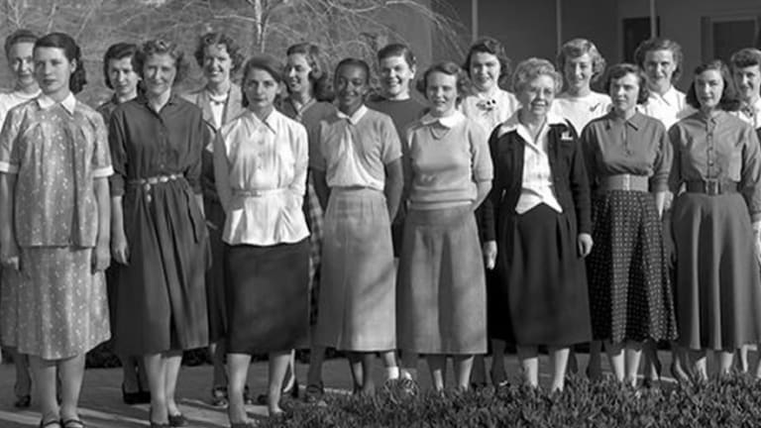
What was the first computer?
Notes:
The first computers where people—often women (Source: www.history.com)
They used slide rules, and books of pre-calculated values—often to create books used to fire artillery. (WW I artillery transformed European forests in the “the surface of the moon” –Dan Carlin ”Hardcore History” podcast.
”Hidden Figures” movie about women and NASA during the Apollo program.

Slide 4
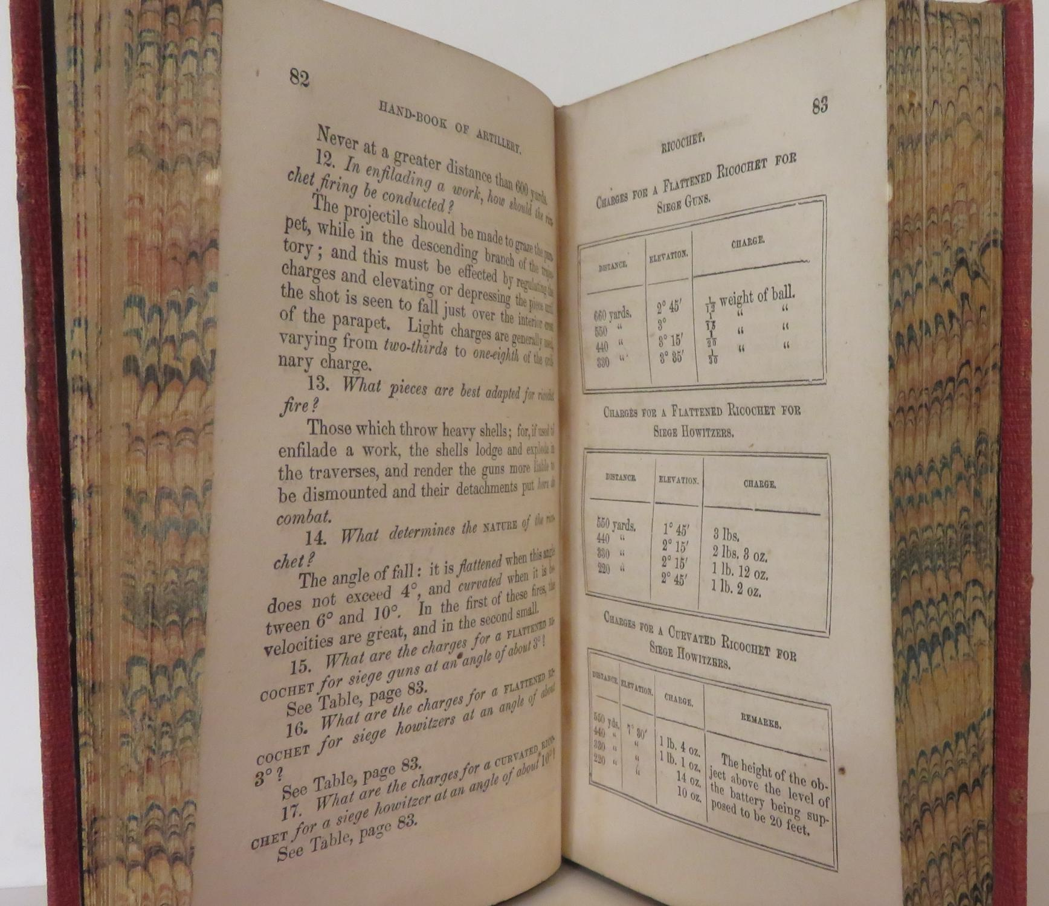
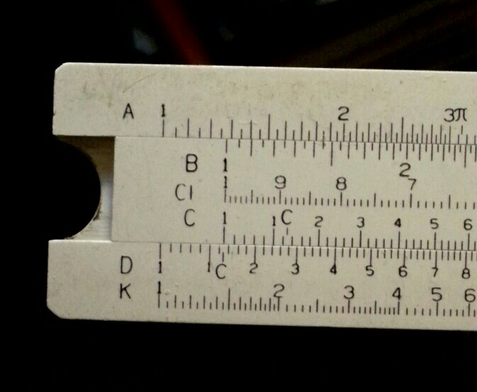
What was the first computer?
Notes:
They used slide rules, and books of pre-calculated values—often to create books used to fire artillery. (WW I artillery transformed European forests in the “the surface of the moon” –Dan Carlin ”Hardcore History” podcast.
”Hidden Figures” movie about women and NASA during the Apollo program.

Slide 5
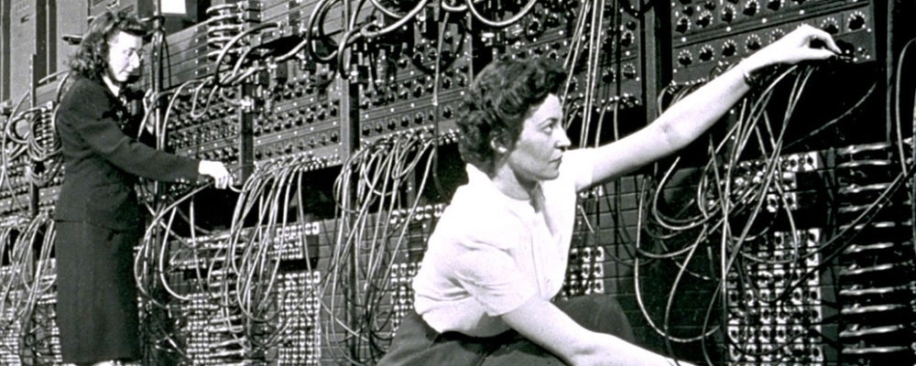
What was the first Programable, Electric, General purpose, Digital computer?
Notes:
The ENIAC (1945).
The Bombe in 1940 was not general purpose. It was designed specifically to break the Enigma cipher in WW II.

Slide 6
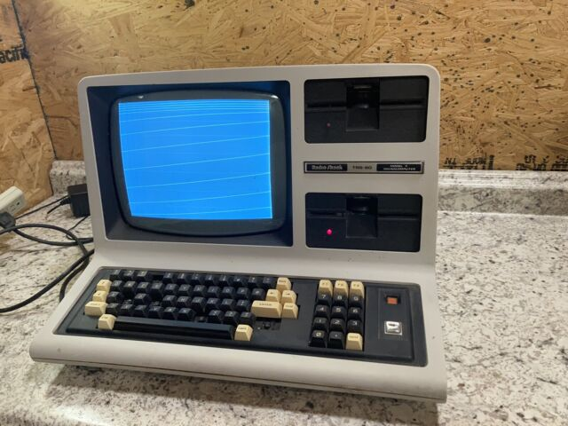
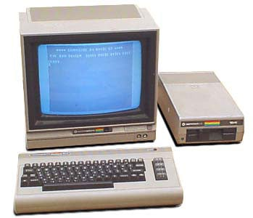
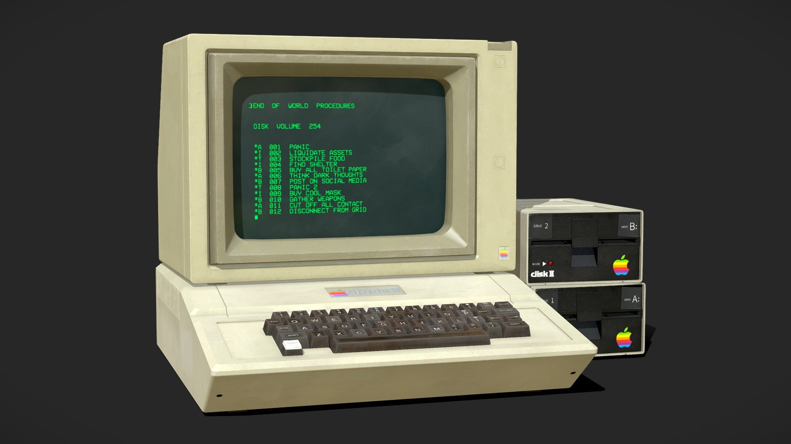
Home Computers of the 1980s
Notes:
Before the personal computer revolution of the 1980s, computers were as big as rooms or entire buildings.
Didn’t do anything out of the box—no applications, just an operating system.
No real permanent storage (hard drive). Data written to tape or floppy. Each user had their own media with them (backpack full of floppy disks).
Not networked. So no security considerations other than software piracy.

Slide 7
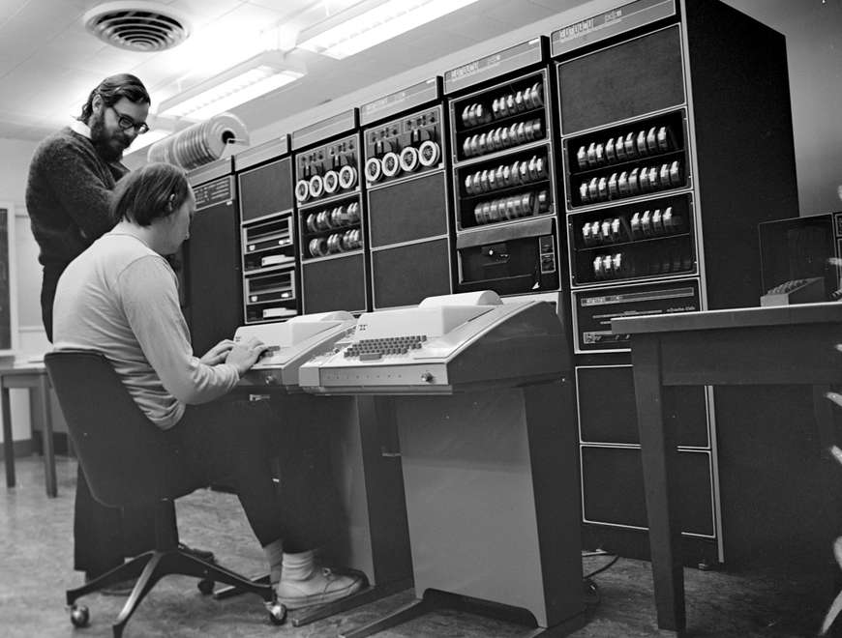
UNIX
Bell Labs (AT&T)
First multi-user operating system
UNIX (1969)
Notes:
Large “mainframe” systems were called “time sharing”. You signed up for a time slot and got to use the computer at that time.
Multi-user systems needed a way to protect the integrity of user files from unauthorized changes, and later confidentiality.

Slide 8
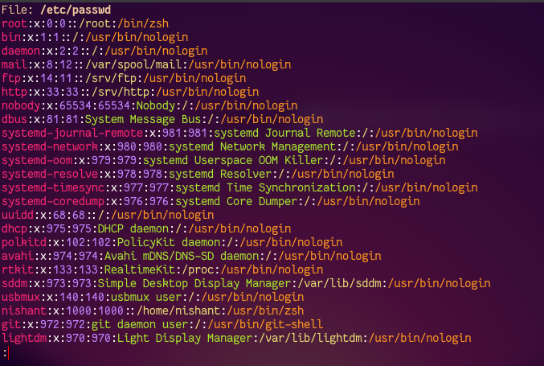
Linux Password file
Notes:
Originally, the /etc/password file contained usernames and passwords.
Now the “x” in the second position refers to the /etc/shadow file.
The problem was that the file had to be accessible by unauthenticated users in order to authenticate them. (Read permission)
The first “cyber security problem”. How do we “hide” a password from an untrusted user? (Answer: Hashes)

Slide 9
What is a hash?
Some password “P”
Some token “T”
Some algorithm “A”
Some hash “H”
A(P+T) = H
P = Dog
T = Cat
A = MD5 (can be anything)
SHA2(DogCat) = 2326150552d0df0630157e36104d62e1
Try it! md5 –s DogCat

Slide 10
Known Ciphertext Attacks
Give a hash: e2900e261318a2ef26676290eab96850
Can you compute the password (P) and the token (T)?
Notes:
Early attempts to obfuscate passwords used the same token for ALL passwords, making it easy to discover the token, then the password.

Slide 11
Linux Password file
/etc/shadow contains one-way hash of passwords
Readable only by root
Rainbow tables
Vulnerabilities in hashing algorithms

Slide 12
Different types of user authentication
Something you know: a password
Something you have: an RSA token, Ubikey, (or smart phone*)
Something you are: fingerprint, iris scan, hand geometry, facial recognition
All result in a hash!
Then that hash must be “passed” to an authenticator.
Authentication is not authorization
“Easy” on a single computer, more complicated on a LAN, worse on a WAN.
Notes:
Other problems? (Cross-platform, cross-technology, integrity, brute-force attacks, other ideas?)

Slide 13
Technical details next time
Linux
/etc/passwd
/etc/shadow
LDAP
Windows
Local SAM
NTLM
Active Directory
(Kerberos--Windows2000)

